Slide 1



Operating System
Prof. Sumitra Menaria, Prof. Uma Bhatt, Assistant Professor Information Technology Department

Slide 2

CHAPTER-2
Processes, Thread & Process Scheduling

Slide 3
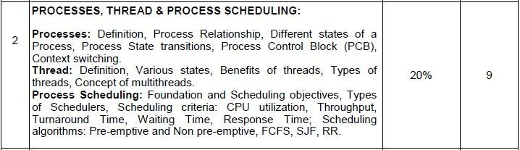
Syllabus

Slide 4
Process
A process is a program in execution.
Process is not as same as program code but a lot more than it.
A process is an 'active' entity as opposed to program which is considered to be a 'passive' entity. Attributes held by process include hardware state, memory, CPU etc.

Slide 5
Main OS Process Related Goals
Interleave the execution of existing processes to maximize processor utilization
Provide reasonable response time
Allocate resources to processes
Support inter-process communication (and synchronization) and user creation of processes

Slide 6
How are these goals achieved ?
Schedule and dispatch processes for execution by the processor
Implement a safe and fair policy for resource allocation to processes
Respond to requests by user programs
Construct and maintain tables for each process managed by the operating system

Slide 7
Process Creation
?When is a new process created
System initialization (Daemons)
Execution of a process creation system call by a running process
A user request to create a process
Initiation of a batch job

Slide 8
Process Termination
?When does a process terminate
Normal exit (voluntary)
Error exit (voluntary)
Fatal error (involuntary)
Killed by another process (involuntary)

Slide 9
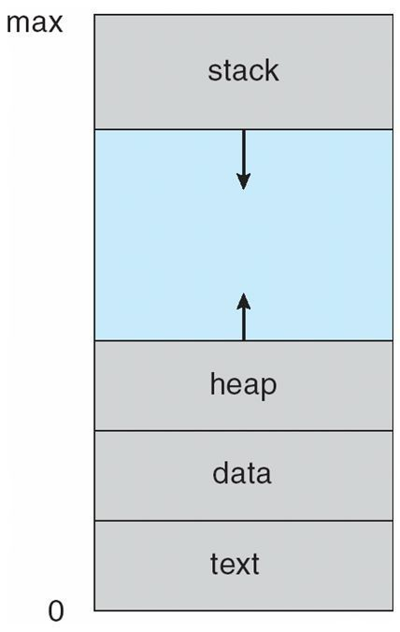
Contd…
Programs are executable(.exe) files generally stored in Secondary Memory.
In order to execute program it must be loaded in main memory.
When a program is loaded into the memory and it becomes process.
Then process memory can be divided into four sections ─ stack, heap, text and data.
Process Stack :Google

Slide 10
Contd..
The Text section is madeup of the compiled program code , read in from non-volatile storage when the program is launched.
The Data section is made up the global and static variables, allocated and initialized prior to executing the main.
The Heap Section is used for the dynamic memory allocation, and is managed via calls to new, delete, malloc, free, etc.
The Stack is used for local variables. Space on the stack is reserved for local variables when they are declared.

Slide 11
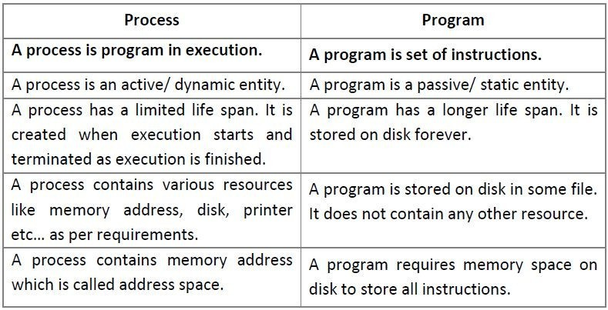
Process Vs. Program

Slide 12
Process State
As a process executes, it changes state.
The state of a process is defined in part by the current activity of that process. The Process state is an indicator of the nature of the current activity in a Process.
Processes in the operating system can be in any of the following states:
¬NEW- The process is being created.
¬READY- The process is waiting to be assigned to a processor.
¬RUNNING- Instructions are being executed.
¬WAITING- The process is waiting for some event to occur(such as an I/O completion or reception of a signal).
¬TERMINATED- The process has finished execution.

Slide 13
Process State & Description
Start
This is the initial state when a process is first started/created.
Ready
The process is waiting to be assigned to a processor. Ready processes are waiting to have the processor allocated to them by the operating system so that they can run.
Process may come into this state after Start state or while running it by but interrupted by the scheduler to assign CPU to some other process.

Slide 14
Contd…
Running
Once the process has been assigned to a processor by the OS scheduler, the process state is set to running and the processor executes its instructions.
Waiting
Process moves into the waiting state if it needs to wait for a resource, such as waiting for user input, or waiting for a file to become available.
For example the process may be waiting for keyboard input, disk access request, inter-process messages, a timer to go off, or a child process to finish.

Slide 15
Contd..
Terminated or Exit
Once the process finishes its execution, or it is terminated by the operating system, it is moved to the terminated state where it waits to be removed from main memory.

Slide 16
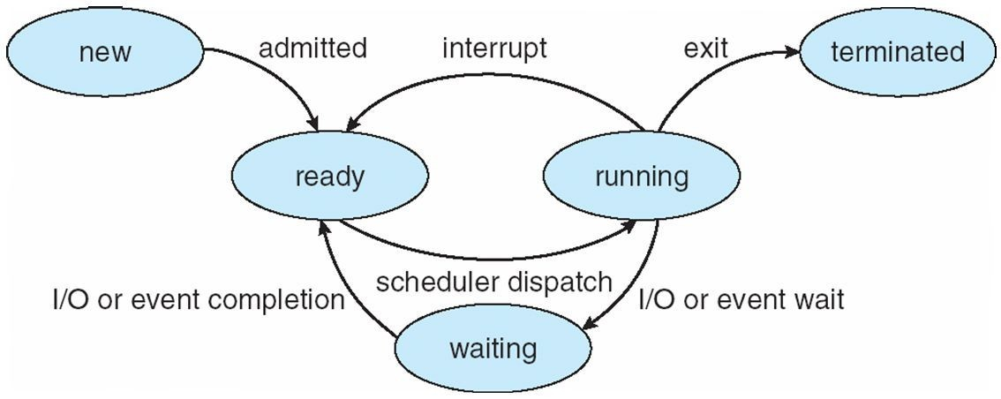
Process State Transitions
Process State^{[ 1 ]}

Slide 17
Process Transitions
Ready --> Running
When it is time, the dispatcher selects a new process to run
Running --> Ready
the running process has expired his time slot the running process gets interrupted because a higher priority process is in the ready state

Slide 18

Contd…
Running --> Blocked
When a process requests something for which it must wait
a service that the OS is not ready to perform an access to a resource not yet available initiates I/O and must wait for the result waiting for a process to provide input (IPC).
Blocked --> Ready
When the event for which it was waiting occurs

